Slide 1
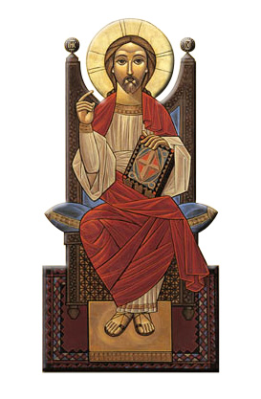
Spirituality of Liturgical Rites
Session 1
INTRODUCTION

Slide 2
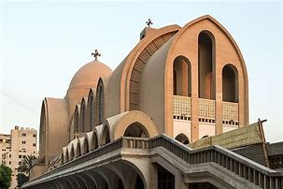
Liturgy (Public Worship) Greek: λειτουργία
PRIEST
DEACONS
CONGREGATION
Eucharist (Divine Liturgy)
Greek: εὐχαριστία

Slide 3
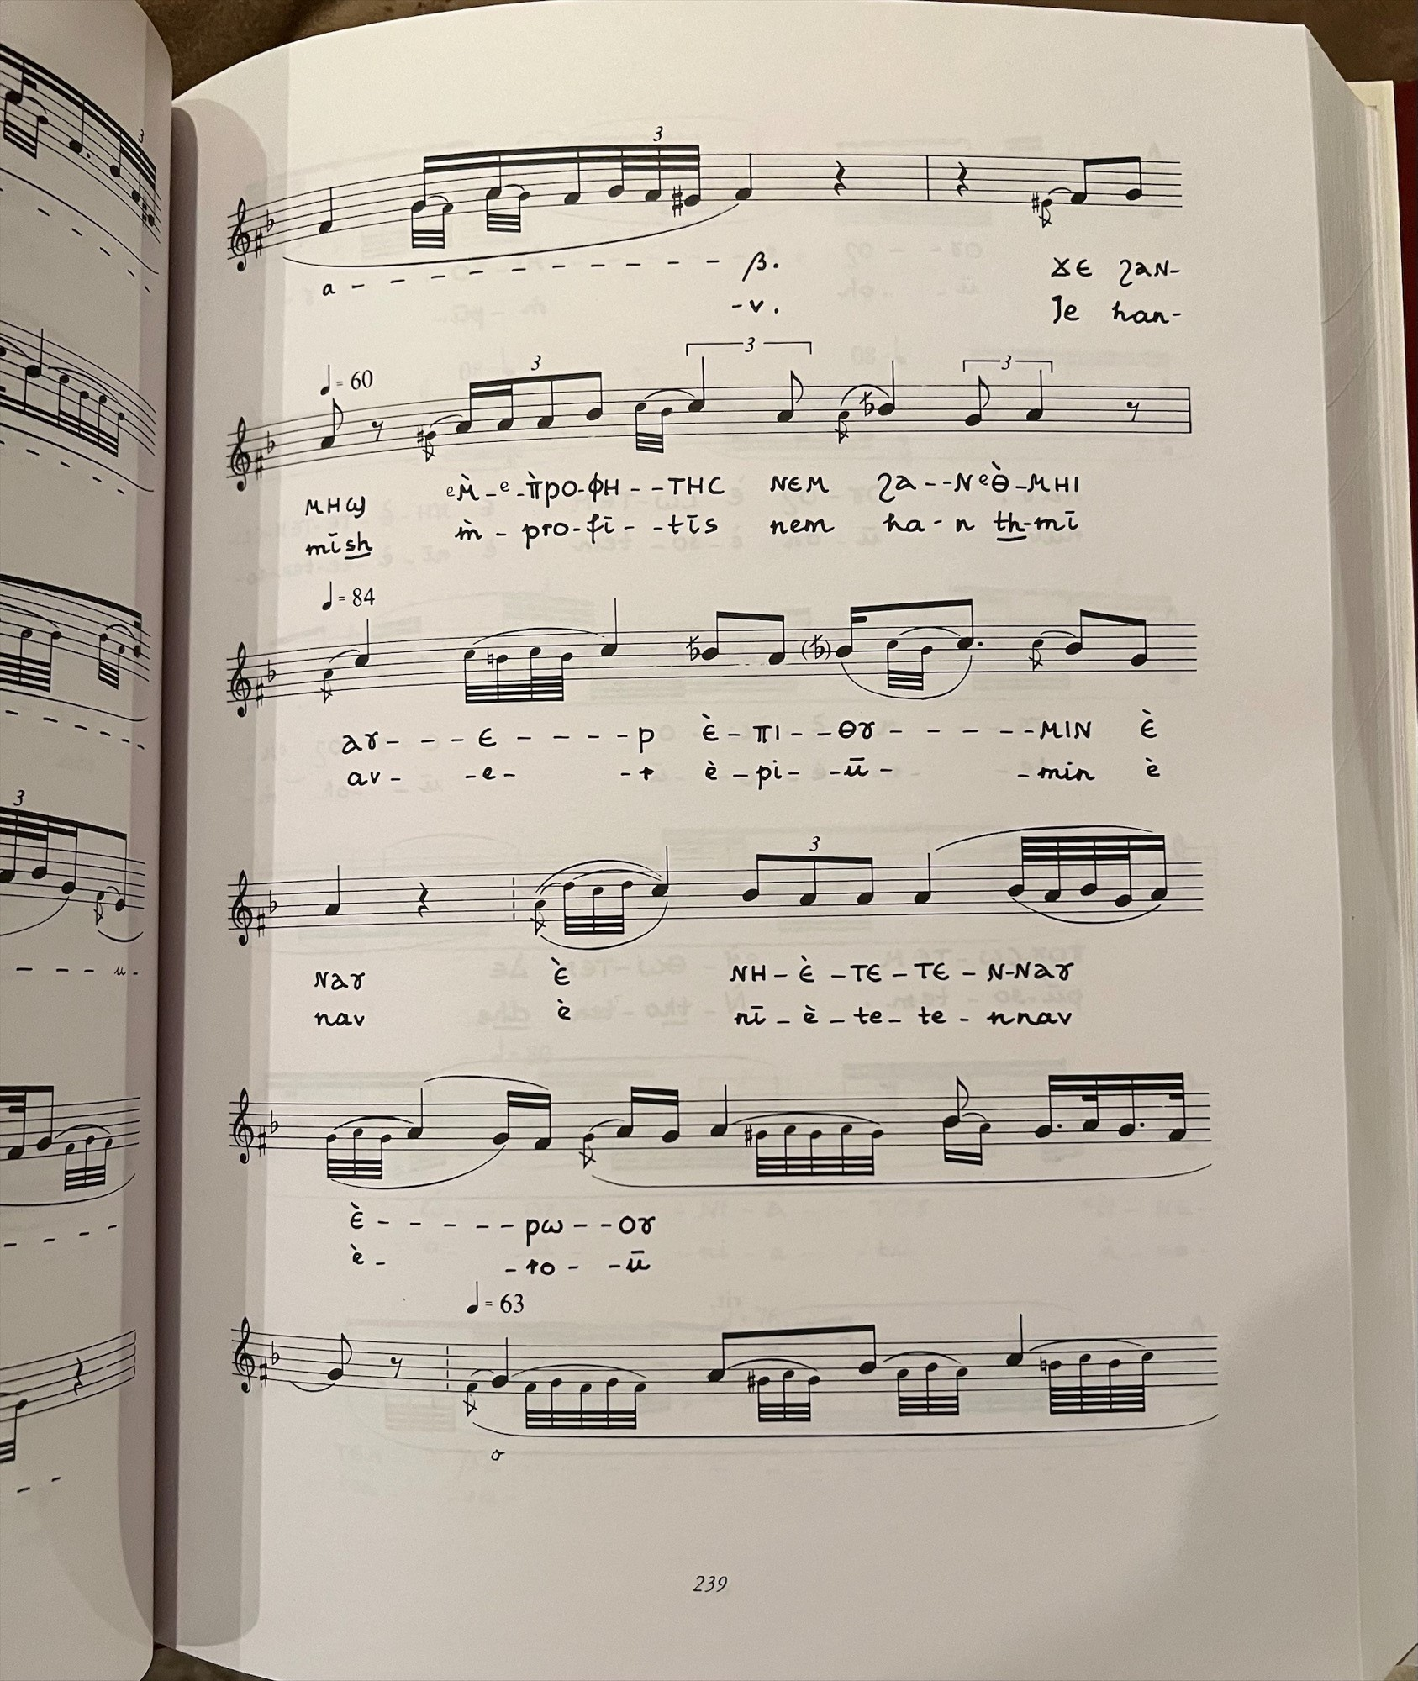
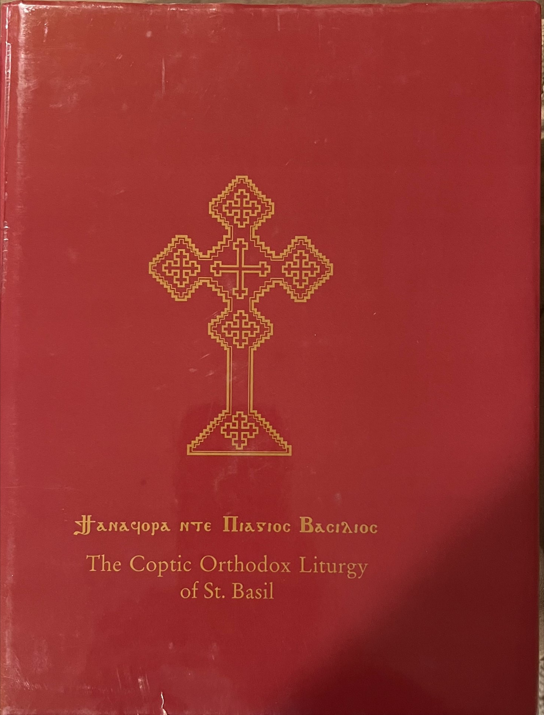
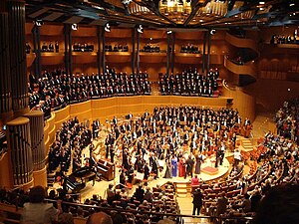
Symphony
Greek word συμφωνία (symphōnía), means "agreement or concord of sound“
(Harmony)

Slide 4
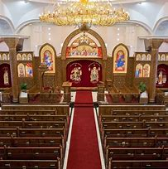
Precautionary Measures
(1) Not coming early to church “Those who seek Me early will find Me” (Proverbs 8:17).
(2) Not participating in the congregation responses “May Your servants, the ministers of this day, hegumens, priests, deacons, clergy, all Your people and my weak self be absolved...”.

Slide 5
Precautionary Measures
(3) Losing focus during the liturgy “I will pray with the spirit and I will also pray with understanding, I will sing with the spirit and I will also sing with understanding” (1 Corinthians 14:15).
(4) Being preoccupied with irrelevant matters “Those who lead, with diligence… fervent in spirit, serving the Lord, continuing steadfastly in prayer” (Romans 12:8-12).

Slide 6
In the House of God
As we enter the church
“But as for me, I will come into Your house in the multitude of Your mercy; In fear of You I will worship toward Your holy temple.” (Psalm 5:7).
Deacons recite psalms: 29 (I will exalt You, O Lord) 92 (The Lord has reigned)
Stand in awe and reverence
Learn the chants and follow the lead deacon

Slide 7
Spirituality of Liturgical Rites
Session 2
Liturgical Symphony

Slide 8
FOUR main Sections:
Raising of the incense
The Offertory
Liturgy of the Word
The Anaphora

Slide 9
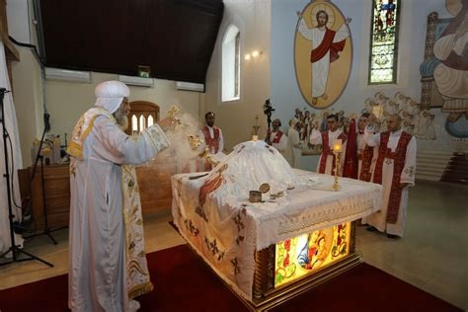
1. Raising of the incense
(a) Vespers - Evening
(b) Matins - Morning
“Then another angel, having a golden censer, came and stood at the altar. He was given much incense, that he should offer it with the prayers of all the saints upon the golden altar which was before the throne.”
Revelation 8:3

Slide 10
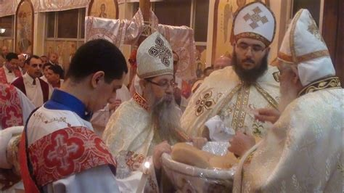
2. The Offertory
Selection of the lamb
“And He took bread, gave thanks and broke it, and gave it to them, saying, “This is My body which is given for you; do this in remembrance of Me.”
Luke 22:19

Slide 11
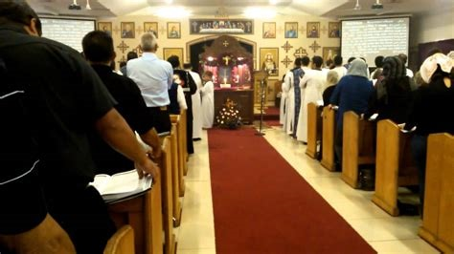
3. Liturgy of the Word (Catechumen)
(1) Pauline Epistle
(2) Catholic Epistle
(3) Acts of the Apostles
(4) Synaxarion (summary of the life of a saint)
(5) Psalm
(6) Gospel
(7) Sermon

Slide 12
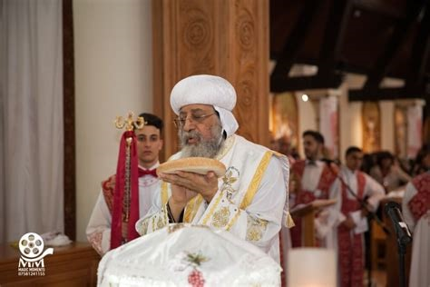
4. Liturgy of the Faithful (Anaphora)
Starts with the Creed and ends with Communion

Slide 13
Symphony
Greek word συμφωνία (symphōnía), means “agreement or concord of sound”
(Harmony)

